Slide 1

Weekly Progress
GE1.02 Shang-Wei Chang
2025/1/23

Slide 2
Content
Core Features & Integration
Performance & Robustness
Image Processing & AI
Debugging & Visualization (Developer Tools)
Successfully Setup New Camera Hardware(still need integration)
Summary

Slide 3
Core Features & Integration
Full Model Integration: Successfully integrated the 1D-CNN Heart Rate (HR) model, the PERCLOS drowsiness model, and the Eye CNN classifier into the main real-time system (`main.py`).
Hybrid Eye State Logic: Implemented a robust dual-check system combining geometric EAR (Eye Aspect Ratio) and appearance-based CNN inference. Added temporal smoothing (Exponential Moving Average) to eliminate "flickering" between open/closed states.
Heart Rate Stabilization: Developed a multi-stage HR filter including:
  Valid Range Filter: Restricts readings to 45-160 BPM.
  Jump Rejection: Automatically ignores sudden spikes (>12 BPM) caused by motion or lighting changes.
  Smoothing: Uses a moving average to provide a steady, readable pulse value.

Slide 4
Performance & Robustness
PS Synchronization: Enforced a 30Hz sampling rate for physiological signals (rPPG/EAR) to match training conditions, even when the camera runs at 60 FPS.
Loop Optimization: Implemented frame-skipping for heavy AI models (Eye CNN runs every 5 frames, HR/PERCLOS every 30 frames) to maintain a smooth 60 FPS UI experience.
Dynamic ROIs: Updated forehead and cheek regions to scale dynamically based on face size and orientation.

Slide 5
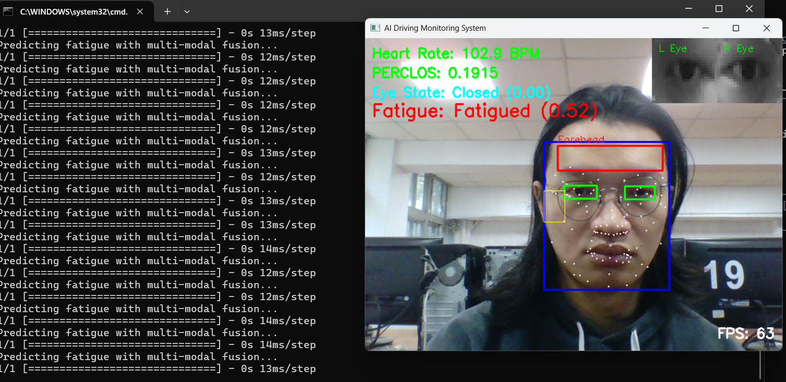
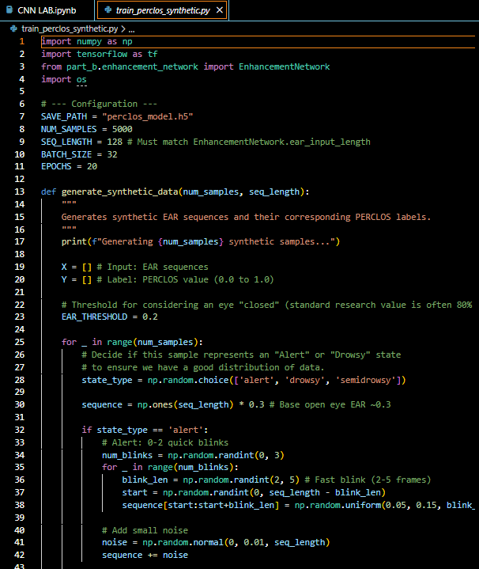
Image Processing & AI
Contrast Enhancement: Integrated Histogram Equalization for eye crops to improve detection accuracy in low-light or high-shadow conditions.
Synthetic PERCLOS Training: Generated a synthetic time-series dataset to train the PERCLOS 1D-CNN model in the absence of a localized DMD video dataset.
Input Validation: Fixed several "AttributeErrors" and "Reshape Errors" by enforcing strict NumPy array casting across the pipeline.

Slide 6
Debugging & Visualization (Developer Tools)
Live Debug Overlays: Added real-time visualization of the 468-point face mesh, forehead/cheek ROI boxes, and an FPS counter.
Eye-In-The-Box: Added persistent display of the actual eye crops being fed to the CNN for live alignment verification.
Raw Metric Stream: Displayed raw P (Probability) and EAR (Geometry) values on the HUD for fine-tuning.

Slide 7
Next Week
Integrating camera from REC. tech.
Start training the model on Vicomtech Driver Monitoring Dataset(DMD).

Slide 8
Thank you for listening
Q&A session

